Slide 1
New technologies in Global New Life Sciences & Health Care Products
BioLaw Annual Meeting, Copenhagen 24 May 2024

Slide 2
DATA ON THE SCALE OF R&D EXPENDITURE IN HEALTH TECHNOLOGIES
According to EUROSTAT data, the pharmaceutical industry is the high technology sector with the highest added value per person employed, significantly higher than the average value for high-tech and manufacturing industries. The pharmaceutical industry is also the sector with the highest ratio of R&D investment to net sales.
Source: Report European Federation of Pharmaceutical Industries Associations 2023

Slide 3
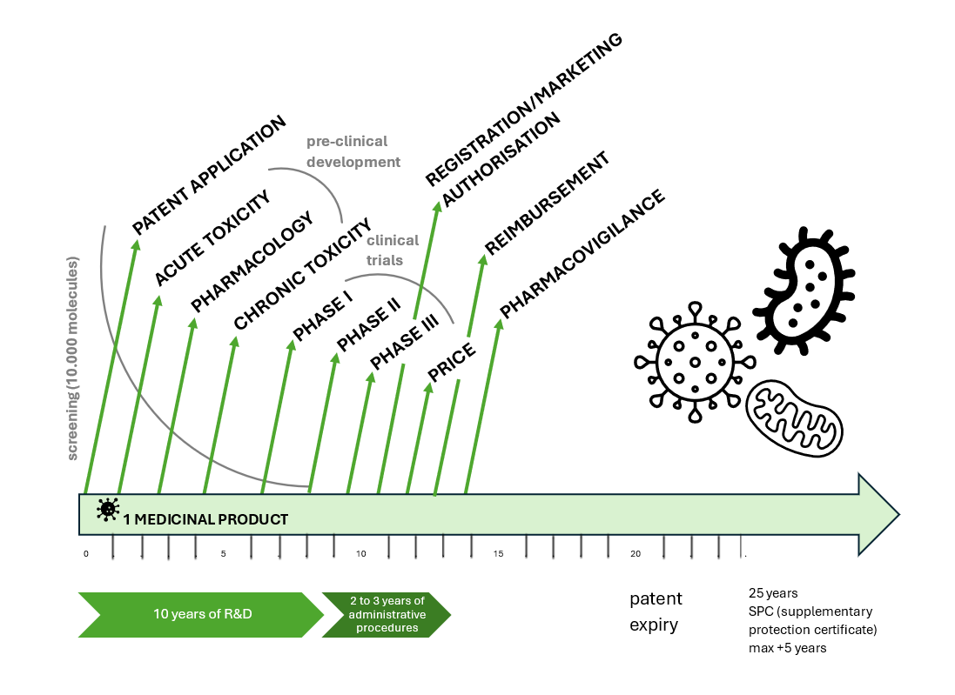
The European legal environment is prepared for the following standard drug development scenario:
The product development life cycle from idea to market launch lasts on average about 1.5 decades, i.e. 15 years;
On average, only one to two of every 10,000 active substances synthesized in laboratories will successfully complete all stages of drug development required to bring the product to market;
The average cost of research and development of a new product that may become a drug is approximately EUR 2 million;
In the above fifteen years, the first five are the patent and toxicological phase and the next five are the clinical trial phase;
Source: https://efpia.eu/media/rm4kzdlx/the-pharmaceutical-industry-in-figures-2023.pdf

Slide 4


What practical impact can NEW TECHNOLOGIES have on the health market?
AI
MACHINE LEARNING
LARGE LANGUAGE MODELS
generative artificial intelligence to design much more efficient chemical synthesis routes
improving the diagnosis process to increase the likelihood of receiving an accurate diagnosis in a relatively shorter time
accelerating the generation of structures of potential drug candidates

Slide 5

CASE STUDY
ACCELERATION OF DRUG MANUFACTURING

Slide 6
The example of one Polish company:
implemented synthetic accessibility screening module;
the platform allows for the assessment of up to 10,000 chemical compounds per hour in terms of synthesis possibilities (SAS Score);
this information allows for the selection of molecules and the isolation of units with the greatest potential;
after sending information about chemical compounds to the system, a set of advanced algorithms, cheminformatics libraries and machine learning models is launched;
the process of analysis, verification and design begins.
The company operates using technologies that use machine learning models. The platform uses machine learning to design drugs by automating the process of searching a database of chemical compounds and predicting their biological properties. Thanks to an in-depth analysis of chemical data sets and information about their molecular structure, the company can generate new proposals for chemical compounds potentially effective as drugs.
Prawo Krajowe

Slide 7



SHORTENING OF CLINICAL TRIAL STAGE / performance evaluation the technology speeds up the decision-making process, identifies a group of patients with an increased risk

Slide 8
MAP OF LIFE SCIENCE PRODUCTS FROM THE PERSPECTIVE OF LEGAL PILLARS AND REGULATORY LAW
There can be differentiated the following segments within the sector of life science from the perspective of legal regimes of marketing authorization:
pharmaceuticals (medicinal products), including advanced therapy medicines; and separately raw materials (medical cannabis);
medical devices, in accordance with ISO 14155:2011, divided into four categories, including software, equipment; separate category is formed by medical devices to in vitro diagnostics;
cosmetics;
products subject to food sector regulatory authorities, including novel food, dietary supplements;
products subject to sanitary supervision, including products of general application of surface cleaning; chemicals;

Slide 9
The MAP - continued
wearables, including health devices, and devices processing information about health state of the end user in respective sectors (fitness, fashion, sport);
borderline products, like:
1) Panax Ginseng (with Pharmacopeia substance RG1, RG3 and RB1) is an example of medicinal product and novel food (food supplement);
2) software – depending on properties, can be medical device or wearable or element of cosmetics or element of medical device;
3) cleaning agents – may be an example of an element of medical device if the part of surgery tool is disinfected by such agent; this may be a biocidal chemical agent or it may be a standard cleaning agent subject to sanitary inspection;
4) hemp – it may be either food supplement or medicinal product in the form of medical cannabis.

Slide 10

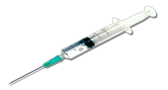
Difficulty of marketing the product
Marketing new generation diagnostics product
Strict legislative classification of products vs declarations of manufacturer vs new categories of products

Slide 11
PLACE IN LAW OF NEW TECH IN „CURE” INDUSTRY – PROBLEMS OF DEFINITIONS
NON-STATUTORY TERMS
Life science - a group of fields of science that focus on living organisms. These include biology, biotechnology, genomics, proteomics, pharmacy, biomedicine and even bioinformatics.
Healthcare - improvement of health via the prevention, diagnosis, treatment, amelioration or cure of disease, illness, injury, and other physical and mental impairments in people; preventing, diagnosing, treating, alleviating or curing diseases, illnesses, injuries.
STATUTORY TERMS
CLINICAL TRIAL vs. CLINICAL STUDY in accordance with Regulation 535/2014
Clinical trials are interventional studies and involve investigational medicinal products, whereas clinical studies can include both interventional and non-interventional studies but do not involve investigational medicinal products.
MEDICINAL PRODUCTS vs. MEDICAL DEVICES for medical procedures vs. diagnostic procedures vs. in vitro.

Slide 12
SUBSTANTIVE LAW REQUIREMENTS
SUCCESS IN MARKETING AUTHORISATION
REGULATORY REQUIREMENTS

Slide 13

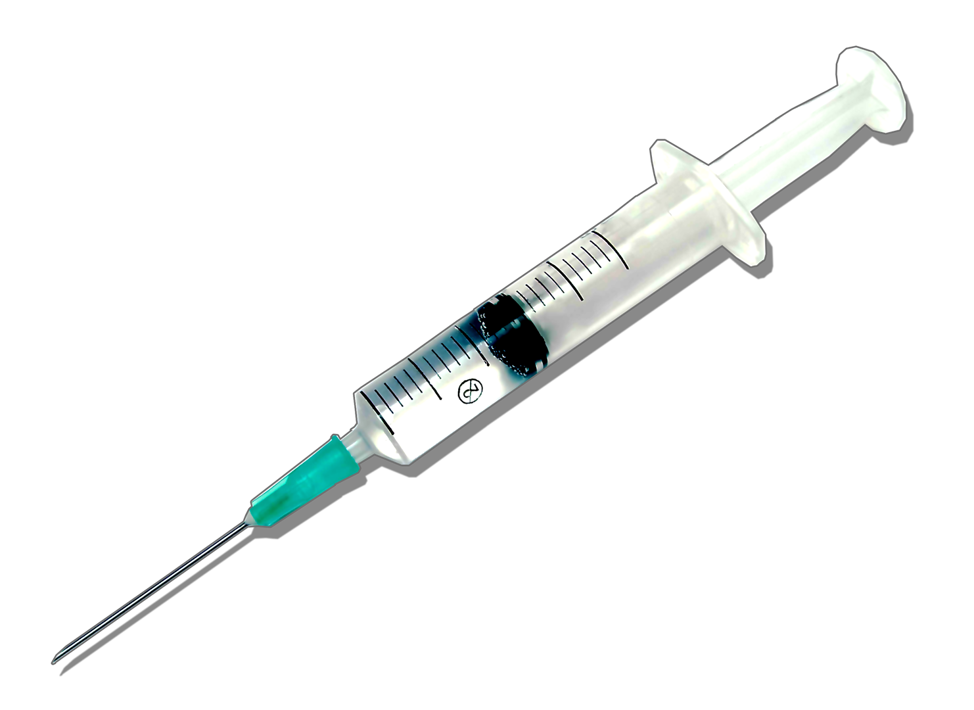
LEGAL ENVIRONMENT IN EUROPE
DIFFERENCES IN EU AND NATIONAL LAW
xxx
PRIORITY OF EMA
Regulation 2017/745 and IVMD (in vitro diagnostics medical devices) – main sources of medical devices
National law supplements administrative procedures
PRIORITY OF NATIONAL PHARMACEUTICAL LAW
EU LAW regulates specific sectors –
Regulation 536/2014 (clinical trials).
EMA – lawmaker for clinical trials
xxx
xxx
xxx
xxx

Slide 14
LEGAL ENVIRONMENT IN EUROPE for medicines – additional information
National pharmaceutical law – main act and around 6.5 thousand small individual implementing acts / ordinances, such as directives, for example rules for running pharmacies, rules for financing medicines, rules for public procurement for hospitals;
Regulation (EU) No 536/2014 of the European Parliament and of the Council of 16 April 2014 on clinical trials on medicinal products for human use and repealing Directive 2001/20/EC (OJ L. 2014, No. 158, page 1, as amended). – This is a document which regulates overall a specific stage of marketing authorization, i.e. clinical trial.

Slide 15
MEDICAL DEVICE – GENERAL DEFINITION
Art. 2(1) Regulation (EU) 2017/745
"medical device" means an instrument, apparatus, device, software, implant, reagent, material or other article intended by the manufacturer to be used, individually or in combination, on humans for one or more of the following specific medical uses:
- diagnosing, preventing, monitoring, predicting, prognosticating, treating or alleviating disease,
- diagnosing, monitoring, treating, alleviating or compensating for an injury or disability,
- examining, replacing or modifying an anatomical structure or a physiological or disease process or condition,
- providing information through in vitro testing of samples taken from the human body, including those taken from organ, blood and tissue donors,
and which does not achieve its principal intended action by pharmacological, immunological or metabolic means in or on the human body, but whose action may be enhanced by such means.

Slide 16
MAP OF LEGAL SOURCES RELATED TO MEDICAL DEVICES IN EU
MAIN DOCUMENT
Regulation (EU) 2017/745 of the European Parliament and of the Council of 5 April 2017 on medical devices;
ADDITIONAL DOCUMENT
Regulation (EU) 2017/746 of the European Parliament and of the Council of 5 April 2017 on in vitro diagnostic medical devices
CHAPTER VI of the Regulation 2017/745 is ESPECIALLY IMPORTANT - i.e. CLINICAL EVALUATION AND CLINICAL TESTS
Article 61 of Regulation 2017/745 deserves attention here - this is Clinical Assessment. Here, the provision discusses what clinical evaluation of a medical device is. Confirmation of legality is made on the basis of clinical data that provide sufficient clinical evidence.
Another key regulation is Article 72 of Regulation 2017/745 – conduct of a clinical trial.
The sponsor and investigator shall ensure that the clinical trial is conducted in accordance with the approved clinical trial plan.

Slide 17
REGULATORY ENVIRONMENT IN THE EU HEALTHCARE SECTOR
MAP OF SOURCES OF LAW
a) Regulation (EC) No 726/2004 of the European Parliament and of the Council of 31 March 2004 laying down Community procedures for the authorization and supervision of medicinal products for human and veterinary use and establishing the European Medicines Agency (OJ UE. L. of 2004, No. 136, page 1, as amended );
b) Regulation 536/2014 regarding technical regulations on the register of clinical trials in the European Union by the European Medicines Agency;
c) Commission Implementing Regulation (EU) 2017/556 of 24 March 2017 on detailed arrangements for inspection procedures for good clinical practice pursuant to Regulation (EU) No 536/2014 of the European Parliament and of the Council (OJ EU) . L. of 2017, No. 80, page 7).
On the other hand, we have the following national acts (Poland):
a) Act of March 18, 2011 on the Office for Registration of Medicinal Products, Medical Devices and Biocidal Products ( i.e. Journal of Laws of 2023, item 1223, as amended );
b) Act of March 9, 2023 on clinical trials of medicinal products for human use (Journal of Laws, item 605).

Slide 18
TYTUŁ
COMPARISON OF COMPETENCES OF THE EUROPEAN MEDICINES AGENCY AND THE POLISH PHARMACEUTICALS REGISTRATION OFFICE
Placing a product on the market after a clinical trial before the European Union EMA – without acting before the national authority
Legalisation of the product for the entire EU.
Placing a product on the national market after a clinical trial before the national authority – without acting before the European Union EMA
Example: medical cannabis as a pharmaceutical raw material.
Legalisation depends on the respective EU Member States.
Independent procedures – examples.

Slide 19


TYTUŁ
Symbiosis and interpenetration of the Polish and EU systems – examples of procedures
EMA carries out clinical trials system
Polish authority decides about clinical trials
Sponsor acts before the national authority
Prawo Międzynarodowe
Prawo Krajowe

Slide 20
European Medicines Agency:
The European Medicines Agency (EMA) facilitates development and access to medicines for countries within the European Union (EU). EMA evaluates applications for marketing authorization submitted via the centralized procedure, monitors the safety of medicines across their lifecycle and provides information to healthcare professionals and patients.
The medicines included in the work of EMA include medicines for human use, medicines for veterinary use and herbal medicines.
Medical devices are products or equipment intended for a medical purpose. In the European Union (EU) they must undergo a conformity assessment to demonstrate they meet legal requirements to ensure they are safe and perform as intended. They are regulated at EU Member State level, but the European Medicines Agency (EMA) is involved in the regulatory process.

Slide 21
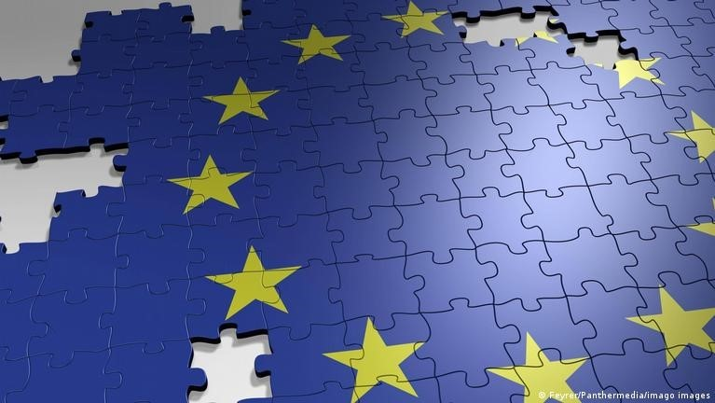
OPPORTUNITIES – CLINICAL TRIALS IN THE EU
Access to CTIS (Clinical Trials Information System);
Transparency of information about clinical trials;
Harmonization and simplification of the electronic application procedure throughout the duration of clinical trials in the EU or EEA;
The introduction of new forms of patient consent; possibility of expressing consent not only in writing but also in audio or visual form;
In the event of problems with the availability of auxiliary medicinal products authorized for marketing, there is allowed the use of products not authorized for marketing in a clinical trial;
Possibility of the existence in practice of loosely interconnected networks of researchers/research institutions.
From 31 January 2023, all applications for authorization of clinical trials in the EU and EEA must be submitted via CTIS in accordance with the Clinical Trials Regulation (3-year transition period).
From January 31, 2025, all ongoing research must be transferred and registered in CTIS. (3-year transition period).

Slide 22
OBSTACLES – CLINICAL TRIALS IN THE EU
The issue of terminology used in Regulation (EU) No. 536/2014 of the European Parliament and of the Council.
Pursuant to Art. 4 of the Regulation on Clinical Trials, "a clinical trial is subject to scientific and ethical evaluation" - the ethical evaluation is carried out by ethical committees in accordance with the law of the Member State concerned;
Scope of Member State supervision:
- withdrawal of consent to clinical trials;
- suspensions of clinical trials;
- imposition of a commitment on the sponsor to change any clinical aspect.

Slide 23
Medical devices undergo a clinical trial (if classified as high-risk and innovative medical devices).
In vitro diagnostic medical devices undergo testing of their performance.

Slide 24
LEGAL STATUS OF SOFTWARE IN HEALTHCARE ?§
SOFTWARE used for production of medicines and medical devices Aim: to accelerate synthesis of chemical compounds; to accelerate computation in clinical trials.
SOFTWARE as element of medical device
SOFTWARE as a separate medical device
ALGORITHM as a separate medical device (Source: https://www.phgfoundation.org/publications/reports/algorithms-as-medical-devices/, the PHG Foundation, the University of Cambridge).
(19) It should be clarified that stand-alone software, where it is specifically intended by the manufacturer for at least one of the medical uses specified in the definition of a medical device, qualifies as a medical device, while software for general purposes, even if used in health care, or software for lifestyle and well-being applications is not a medical device. The qualification of software - as a product or as equipment - is independent of the location of the software and the type of connection between the software and the product. Regulation (EU) 2017/745

Slide 25
The use of AI and language models and machine learning - risks
Language models can make mistakes and even hallucinate non-existent data and sources;
Transferring personal data to technology companies without appropriate regulations may threaten patients' privacy;
Model bias, which may impact health equity. Algorithms trained on biased datasets exacerbate racial and ethnic disparities in access to health care.

Slide 26
NEWEST EU LEGISLATION
Regulation (EU) 2023/2854 of the European Parliament and of the Council of 13 December 2023 on harmonized rules on fair access to and use of data and amending Regulation (EU) 2017/2394 and Directive (EU) 2020/1828 (Data Act)
The Data Act covers all products and it explicitly mentions “medical and health devices” in the recitals. It applies to, among others:
“manufacturers of products and suppliers of related services placed on the market in the Union and the users of such products or services;”
“data holders that make data available to data recipients in the Union;”
“providers of data processing services offering such services to customers in the Union.”

Slide 27
EU Data Act - continued
This includes medical device manufacturers as well as companies that offer data processing services. The latter would include operators of apps, including digital health applications.
All the above requirements also apply to medical devices. This includes the requirement in Article 4 of the Data Act:
“Where data cannot be directly accessed by the user from the product, the data holder shall make available to the user the data generated by its use of a product or related service without undue delay, free of charge and, where applicable, continuously and in real-time. […]”

Slide 28
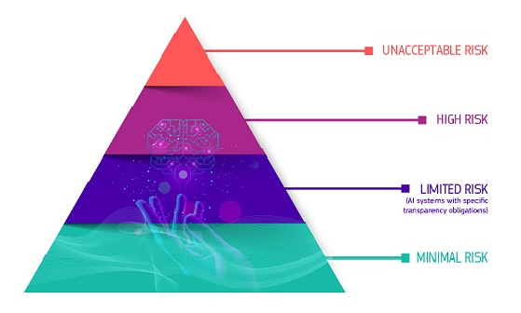
NEWEST EU LEGISLATION
REGULATION OF THE EUROPEAN PARLIAMENT AND OF THE COUNCIL LAYING DOWN HARMONISED RULES ON ARTIFICIAL INTELLIGENCE (ARTIFICIAL INTELLIGENCE ACT) AND AMENDING CERTAIN UNION LEGISLATIVE ACTS
(27) High-risk AI systems should only be placed on the Union market, put into service or used if they comply with certain mandatory requirements. Those requirements should be ensured that high-risk AI systems available in the Union or whose output is otherwise used in the Union do not pose unacceptable risks to important Union.
The general rule is that several pieces of the EU legislation, such as Regulation (EU) 2017/745 on Medical Devices and Regulation (EU) 2017/746 on In Vitro Diagnostic Devices or Directive 2006/42/EC on Machinery, may have to be taken into consideration for one product, since the making available or putting into service can only take place when the product complies with all applicable Union harmonisation legislation.
SOURCE: https://digital-strategy.ec.europa.eu/en/policies/regulatory-framework-ai

